Slide 1
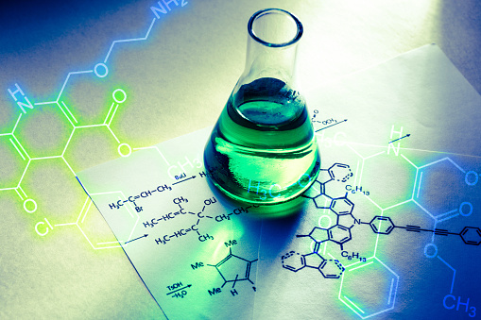
Predictive Modeling of PLGA Nanoparticle Properties for Small Molecule Drug Delivery using Machine Learning.
Vedant Tendulkar
TY AIDS 16014223093

Slide 2
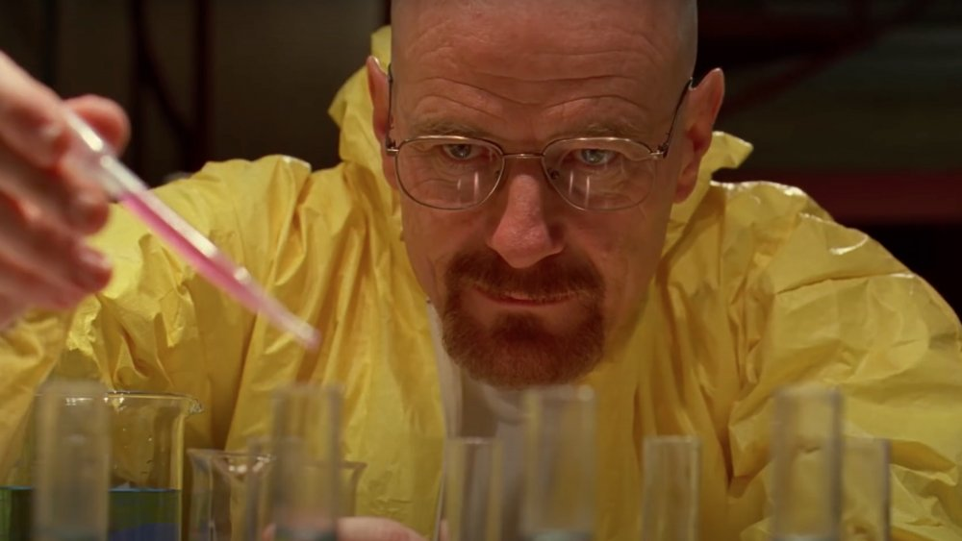
Problem with Drugs
Low solubility
Poor targeting
Side effects
Degradation in body

Slide 3
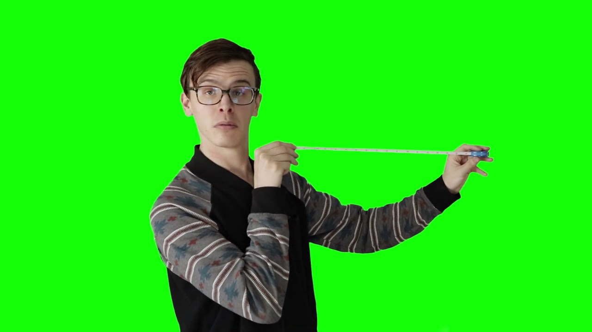
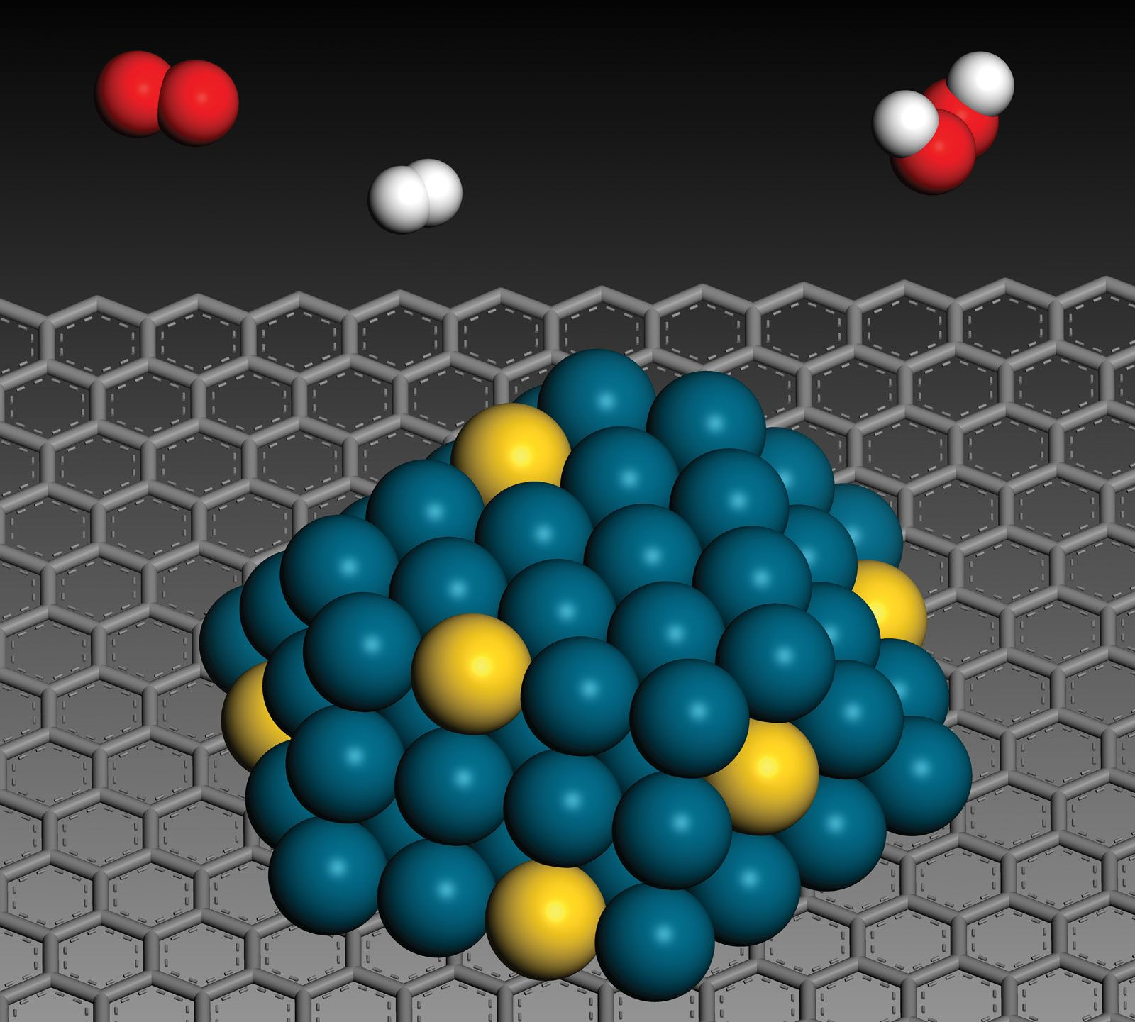
What are Nanoparticles?
Very small particles (nanometer scale)
Used as drug carriers
PLGA=Poly(lactide-co-glycolide)
Biodegradable polymer
Safe for body
Used to make nanoparticles

Slide 4
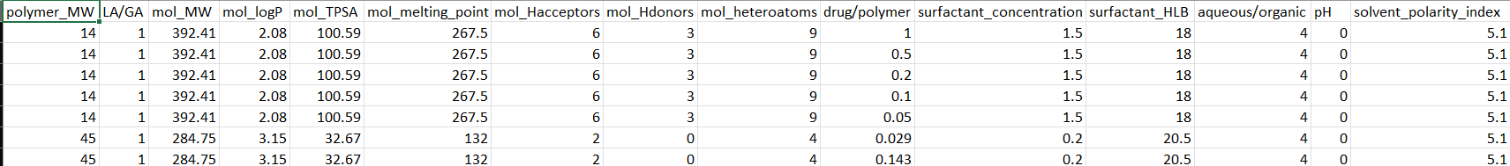
Dataset Overview
433 formulations
15 input features
3 outputs:
Particle Size
EE
LC

Slide 5




Tools & Techniques Used
Libraries Used:
- Pandas → Data handling
- NumPy → Numerical operations
- Matplotlib & Seaborn → Visualization
- Scikit-learn → Machine Learning
Techniques Used:
- Exploratory Data Analysis (EDA)
- Correlation Analysis
- Data Visualization
- Random Forest Regression

Slide 6
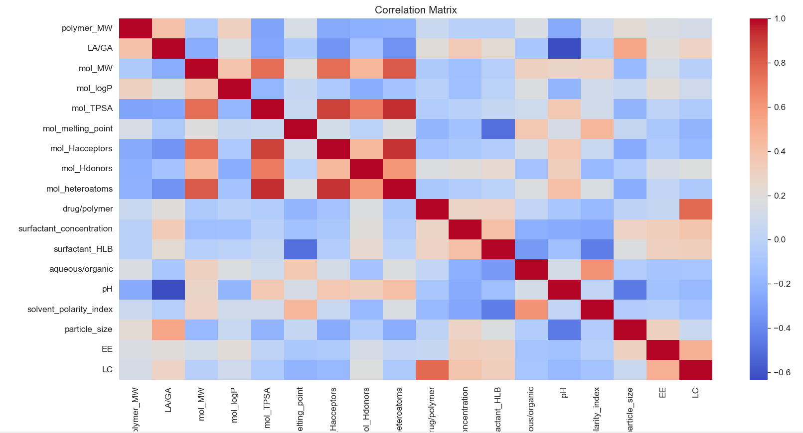
Correlation Heatmap
Relationship between variables

Slide 7
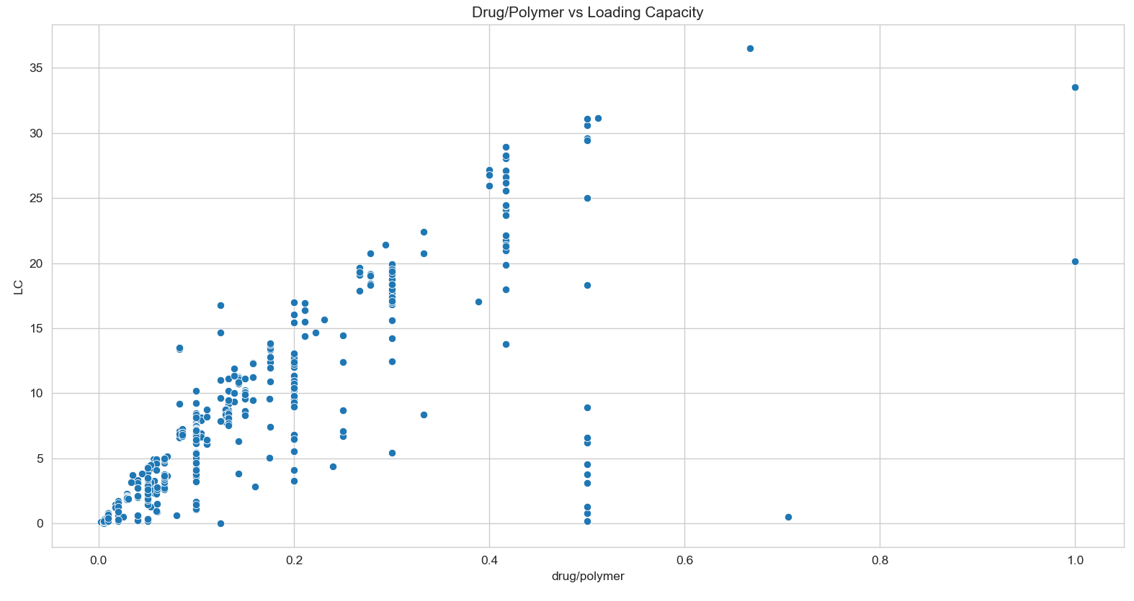
Drug/Polymer vs LC

Slide 8
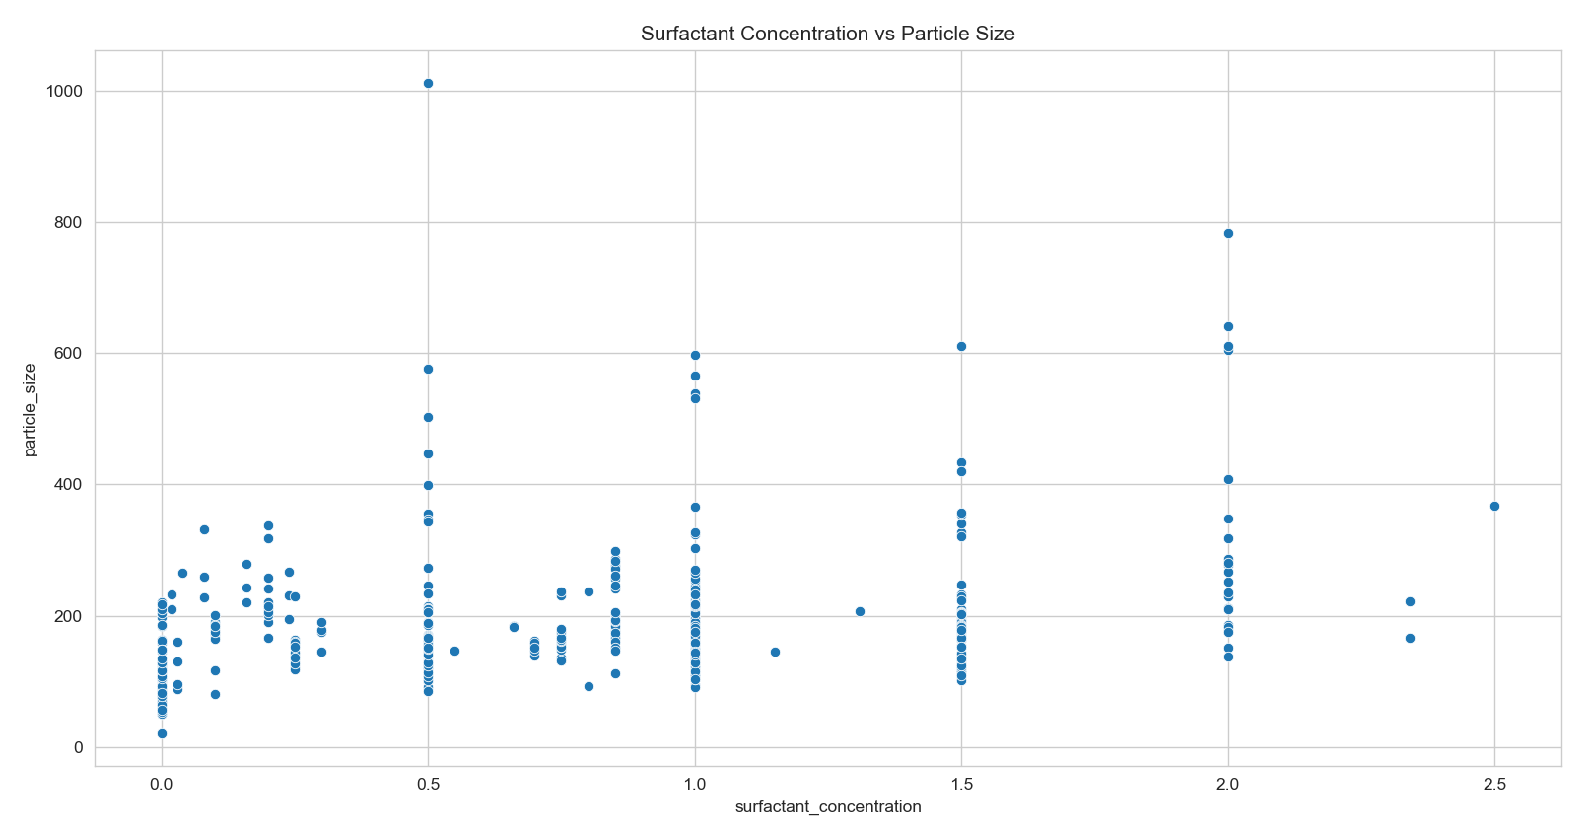
Surfactant vs Particle Size
Surfactant affects size

Slide 9
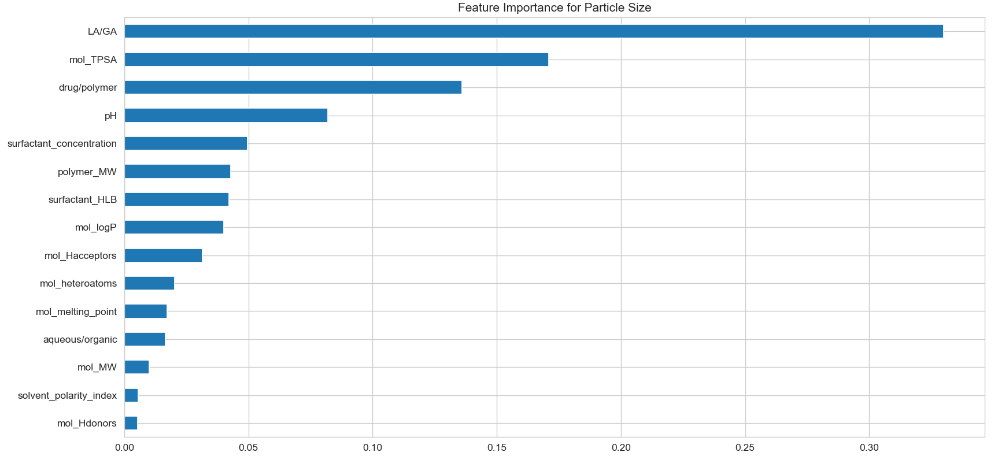
Key influencing parameters identified

Slide 10
References
- Scientific Data Journal (PLGA dataset paper)
- Mendeley Data Repository
- Scikit-learn Documentation
- Research articles on PLGA nanoparticles
Github repo: https://github.com/SWATVSS107/Predictive-Modeling-of-PLGA-Nanoparticle-Properties/tree/main

Slide 11
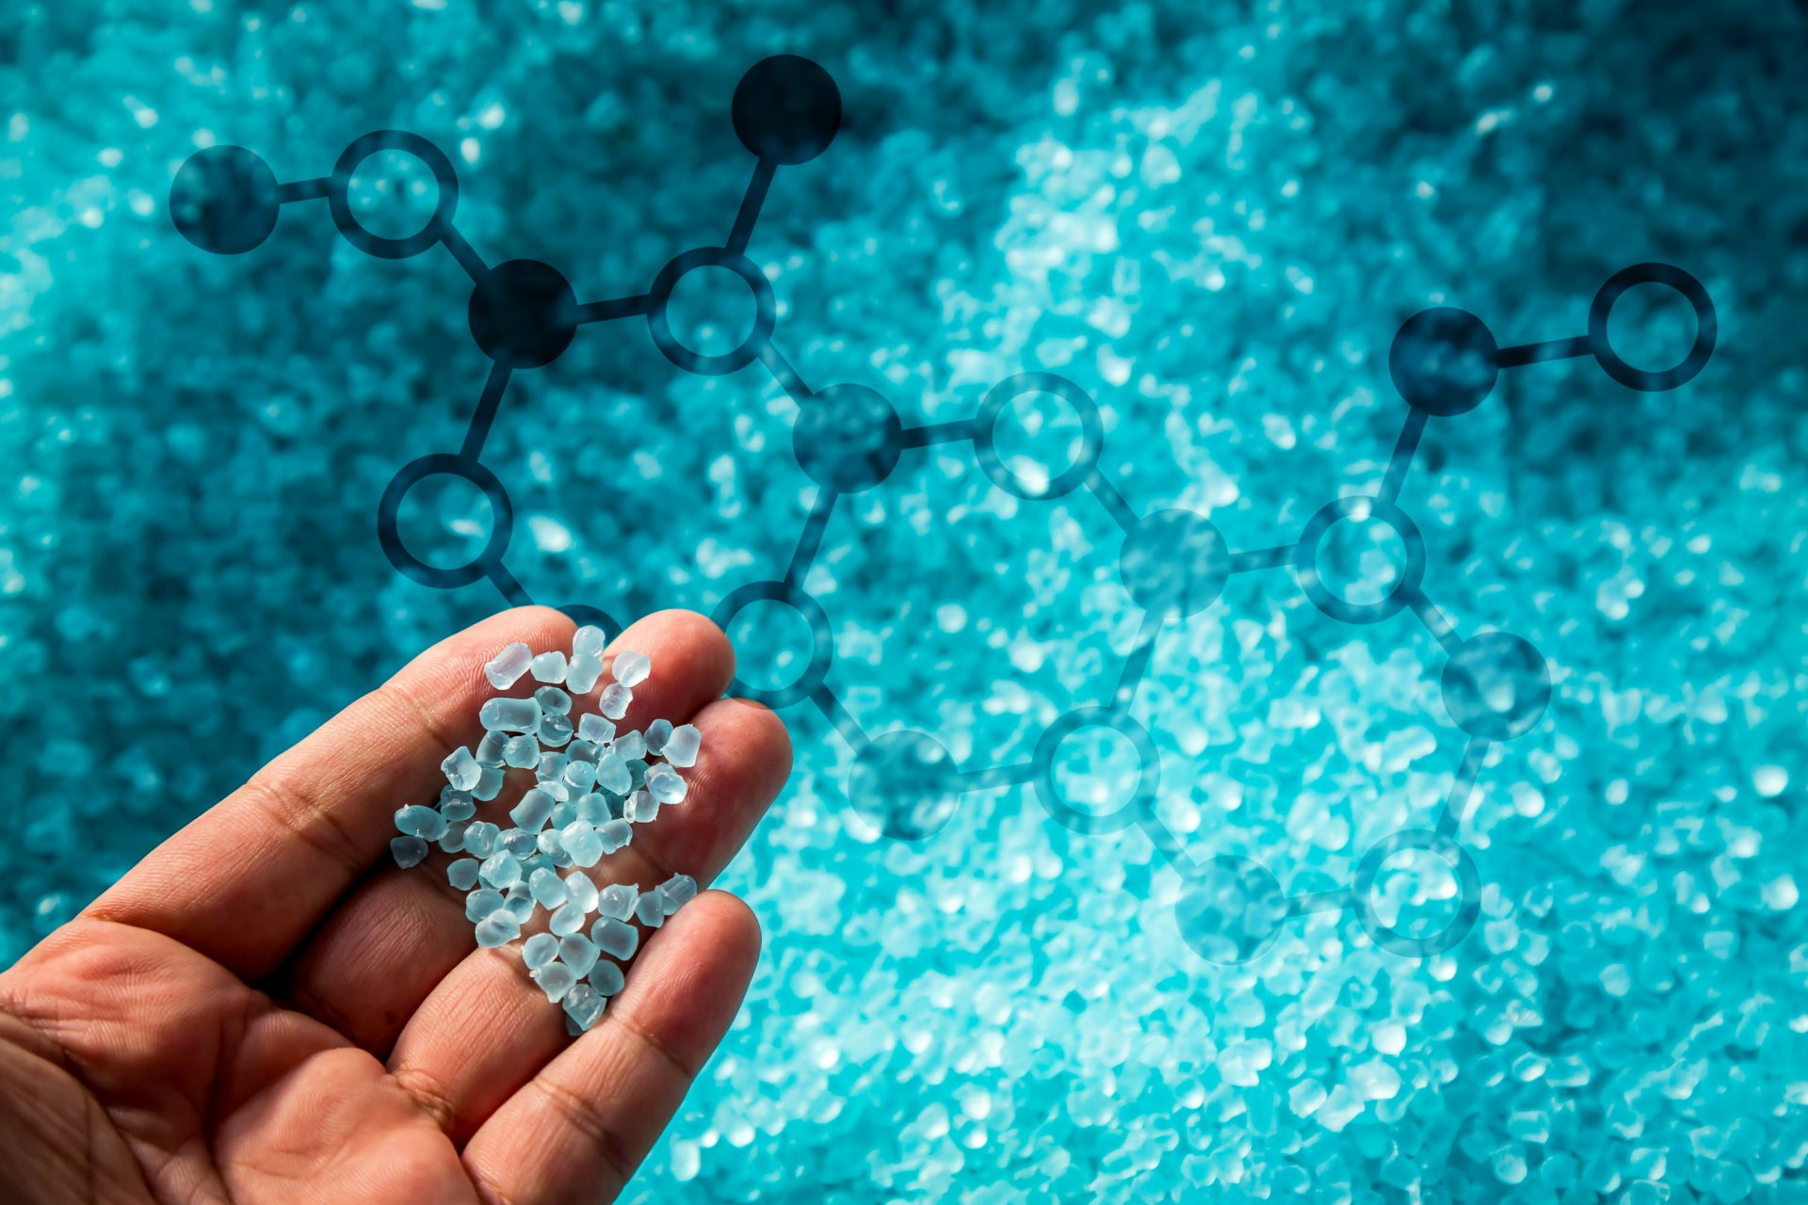
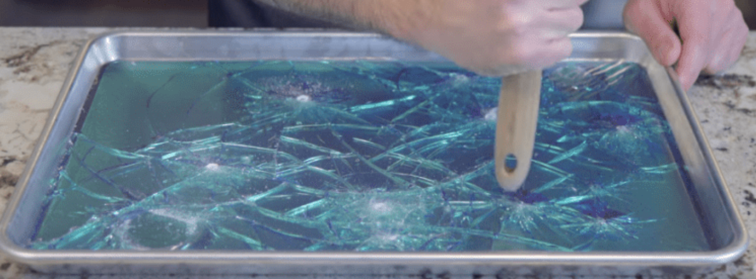
Thank You

